Slide 1
Automatic Flat Coloring
Shuo Wen

Slide 2
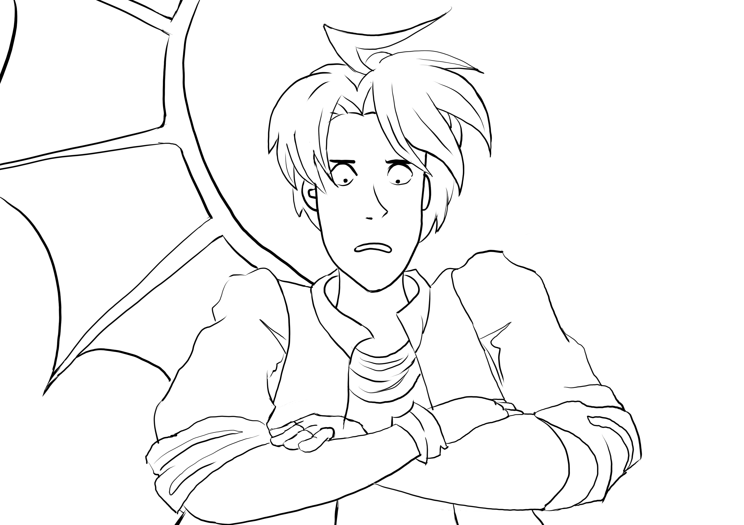


Review - Our Goal
Line-art
Flat coloring
Shadows and other effects added
1. Divide the lineart into regions. (Implemented in GMIC¹)
2. Assign a color for each region.
a. Assign colors for all pixels in the region
b. Take the median of RGB value of the pixels

Slide 3
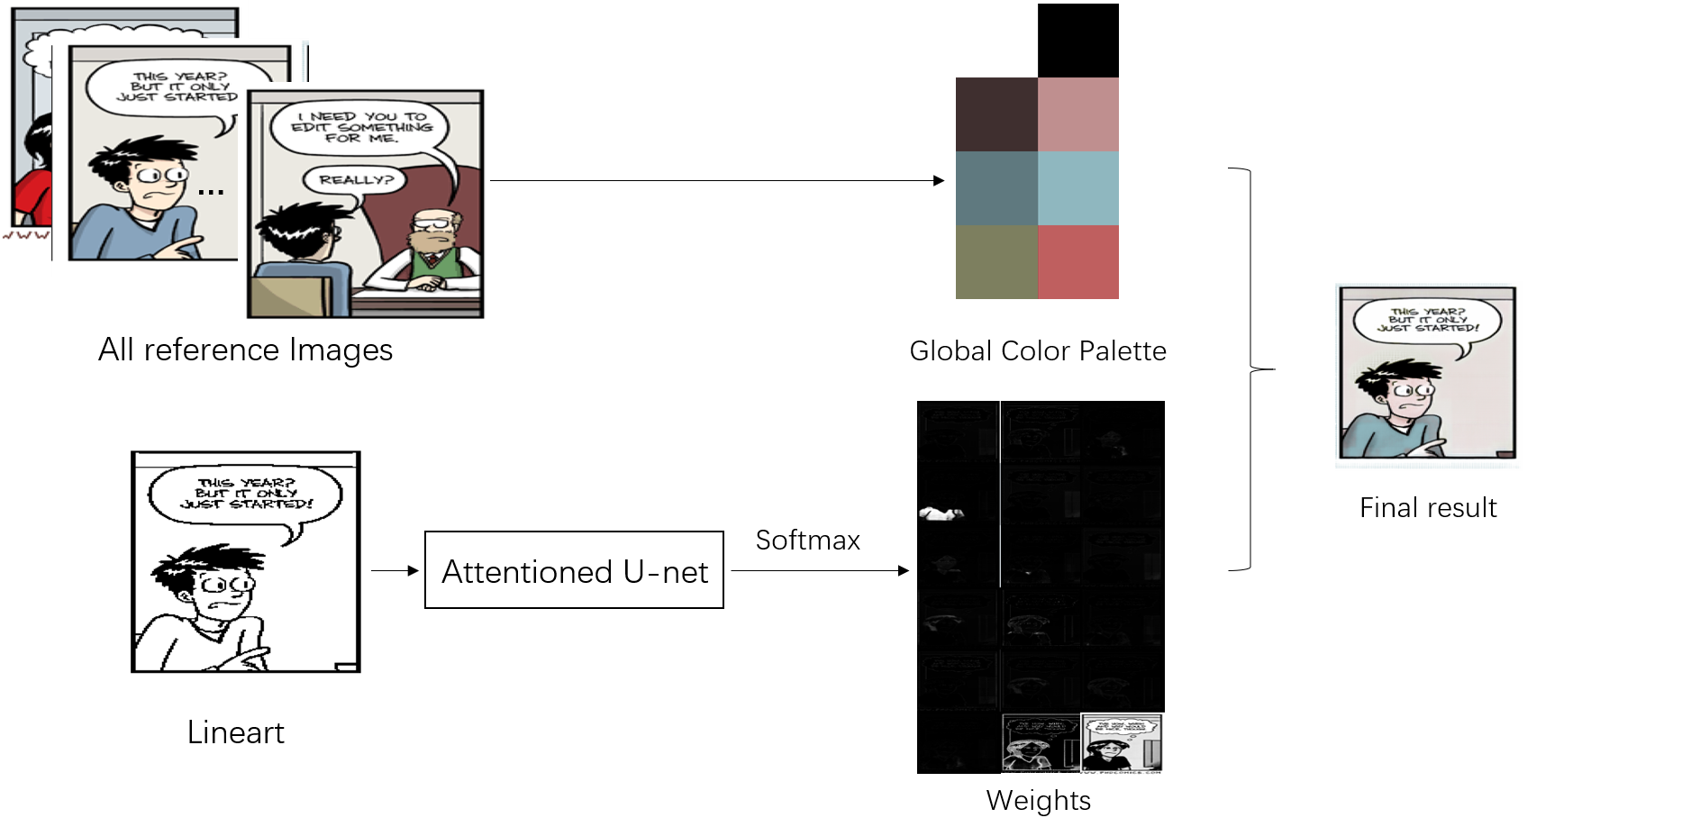
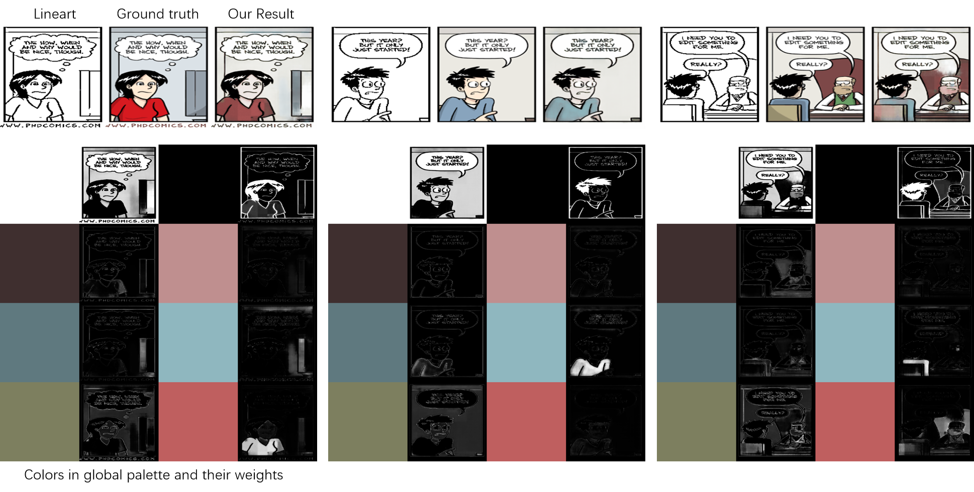
Review – Final model: Global Color Palette + Color mixing

Slide 4
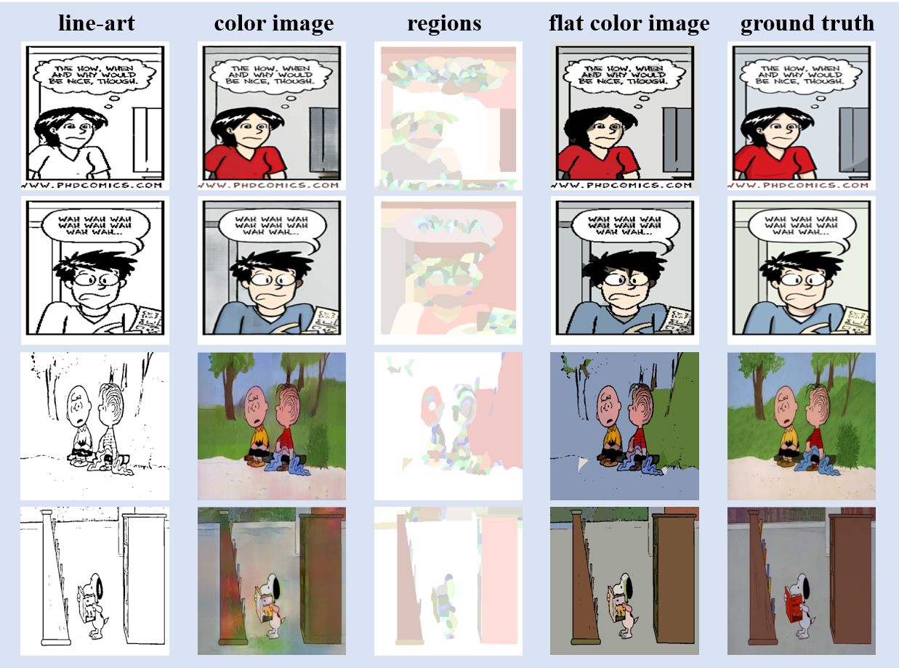
Review – Final result

Slide 5
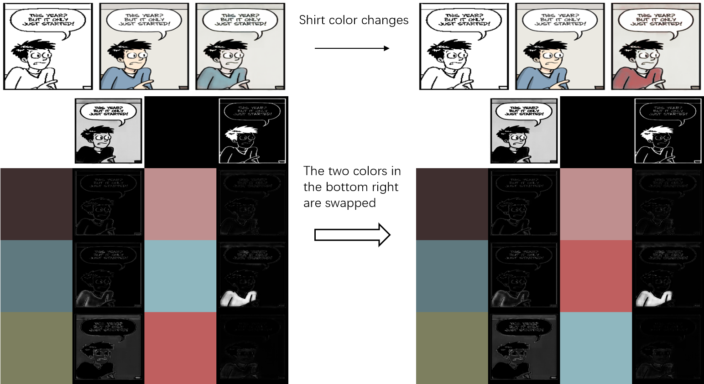
Review - Color transfer

Slide 6
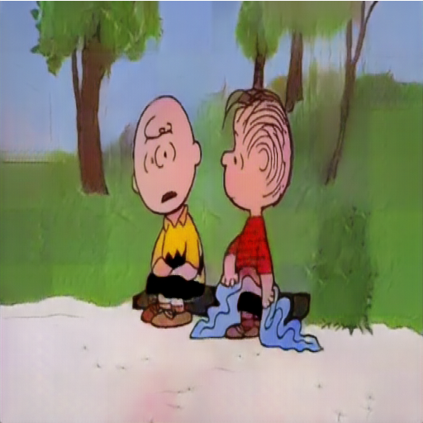
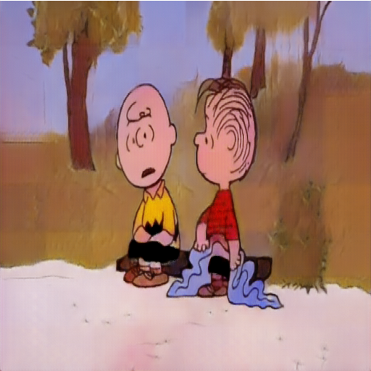
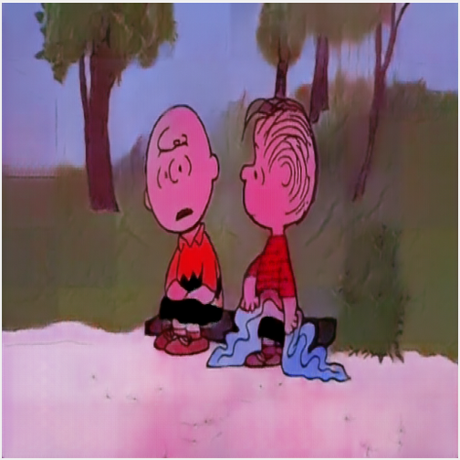
Review - Problem
A more controllable coloring model: color information + structure information

Slide 7

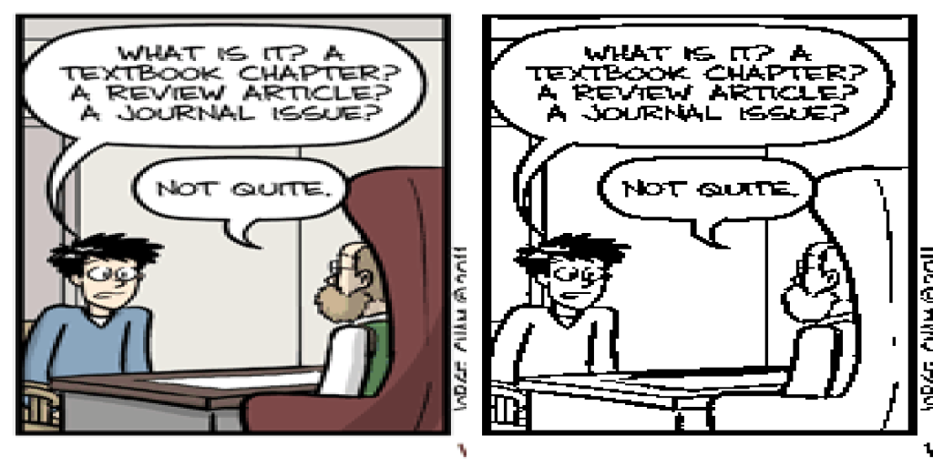
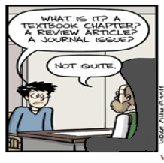

Goal – Examplar based line-art colorization
Lineart reference result

Slide 8
Goal – Examplar based line-art colorization
Lineart reference result
Recognition
Matching
Colorization

Slide 9
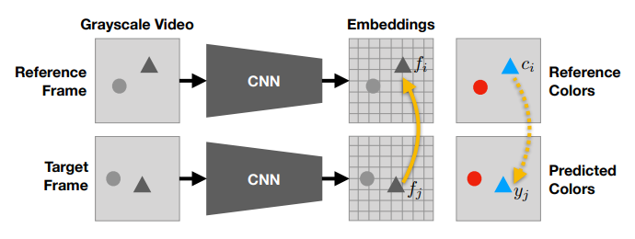
Method – Tracking Emerges by Colorizing Videos

Slide 10
Method – Tracking Emerges by Colorizing Videos
Recognition

Slide 11
Method – Tracking Emerges by Colorizing Videos
Recognition
Matching

Slide 12
Method – Tracking Emerges by Colorizing Videos
Recognition
Matching
Colorization

Slide 13
Method – Tracking Emerges by Colorizing Videos
Recognition
Matching
Colorization
Two main Differences!

Slide 14
Video colorization
Reference frame
Reference frame
Adjacent frames: similar
… …
propagation
propagation

Slide 15
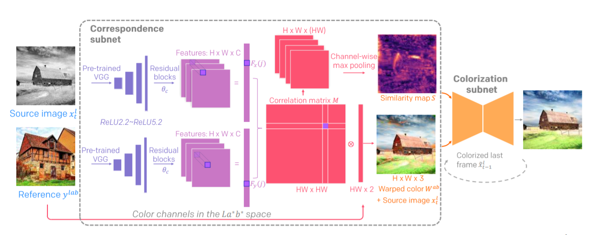
Method – Deep Exemplar-based Video Colorization
Recognition
Matching
Colorization

Slide 16
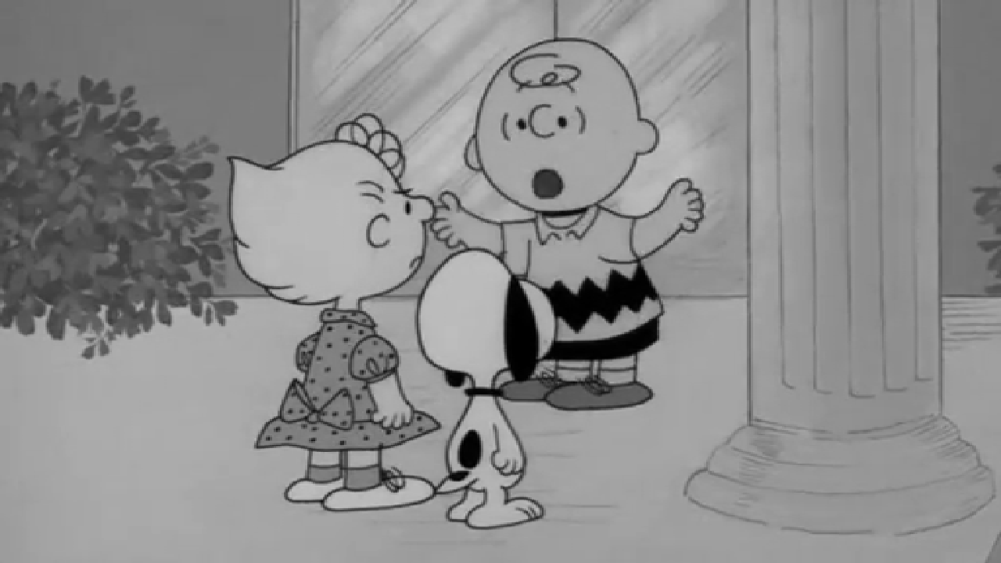
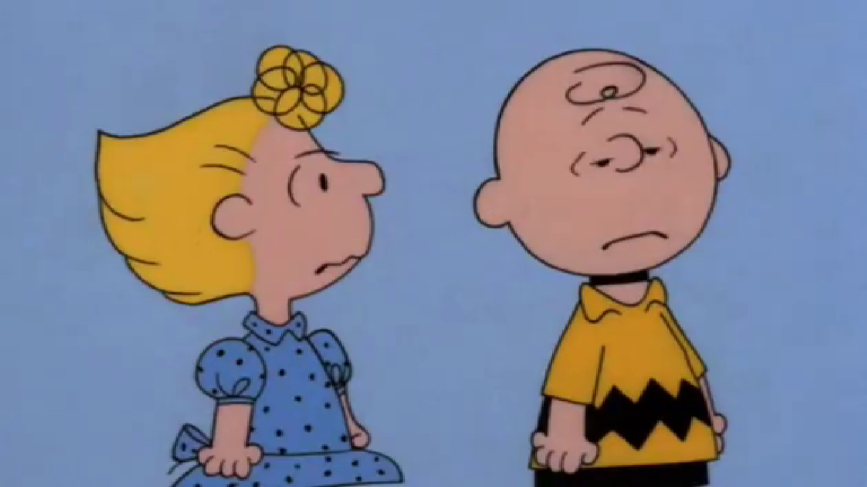
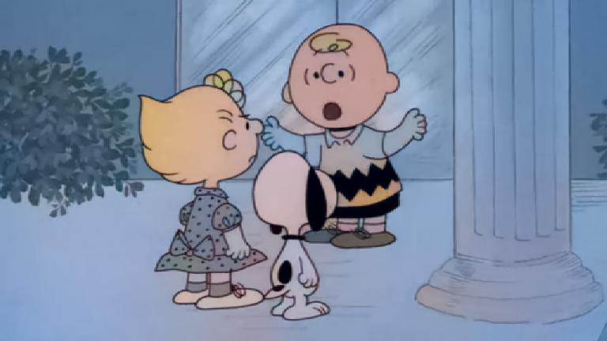
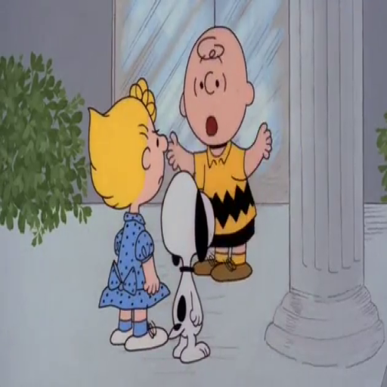
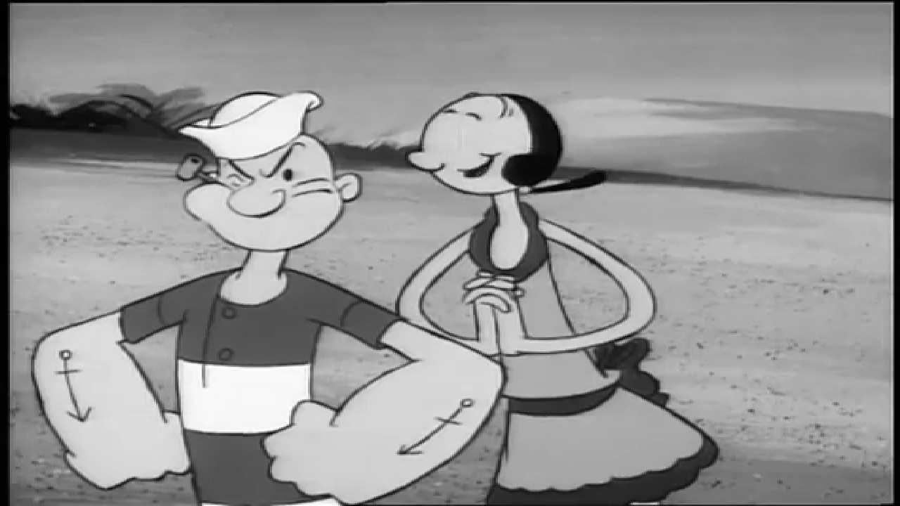
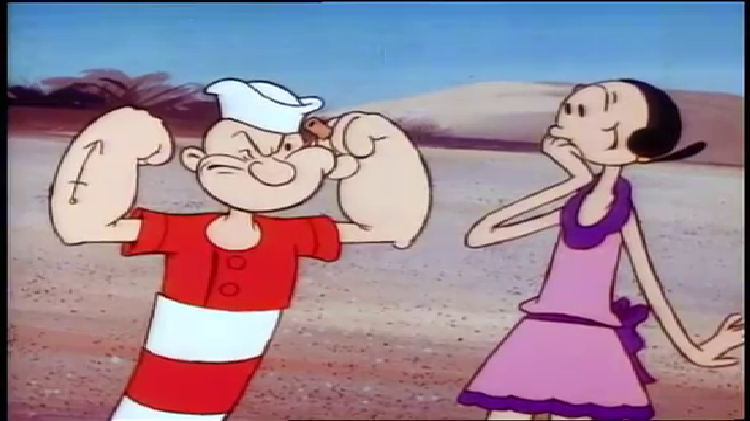
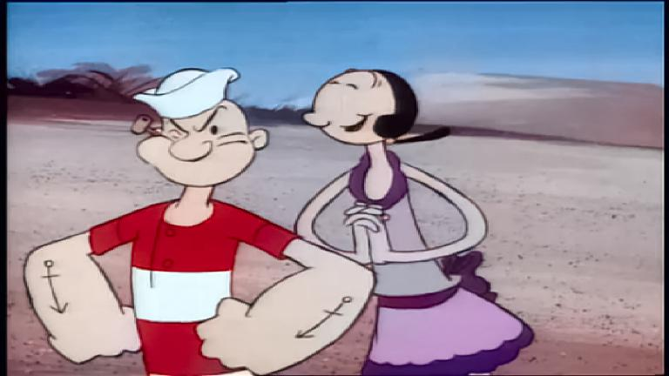
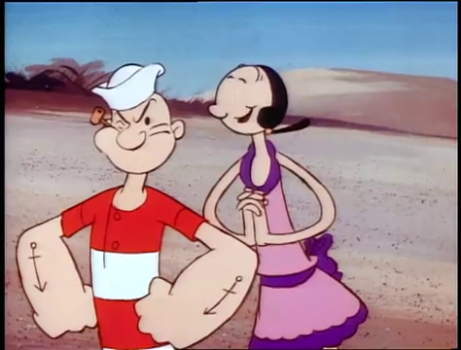

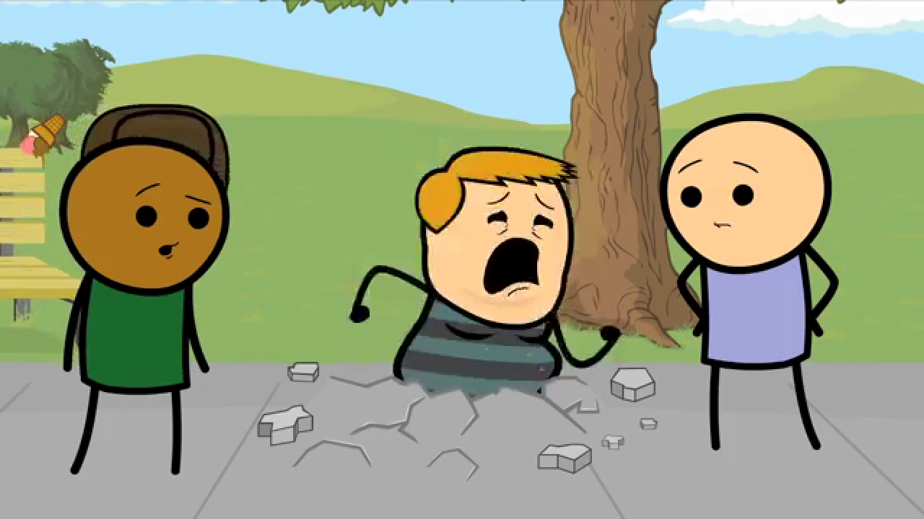
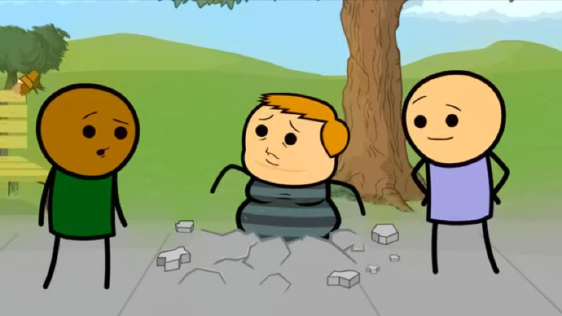
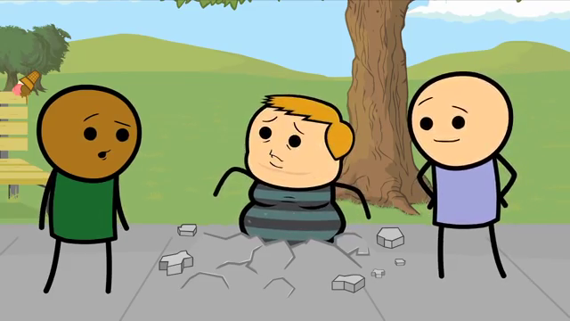
Method – Deep Exemplar-based Video Colorization
Input reference output ground truth

Slide 17
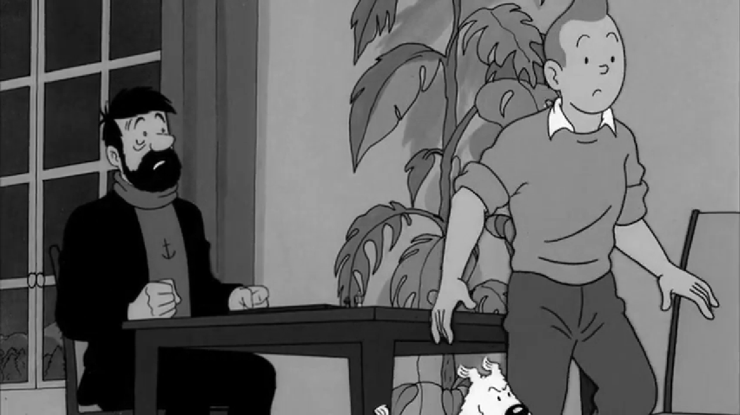
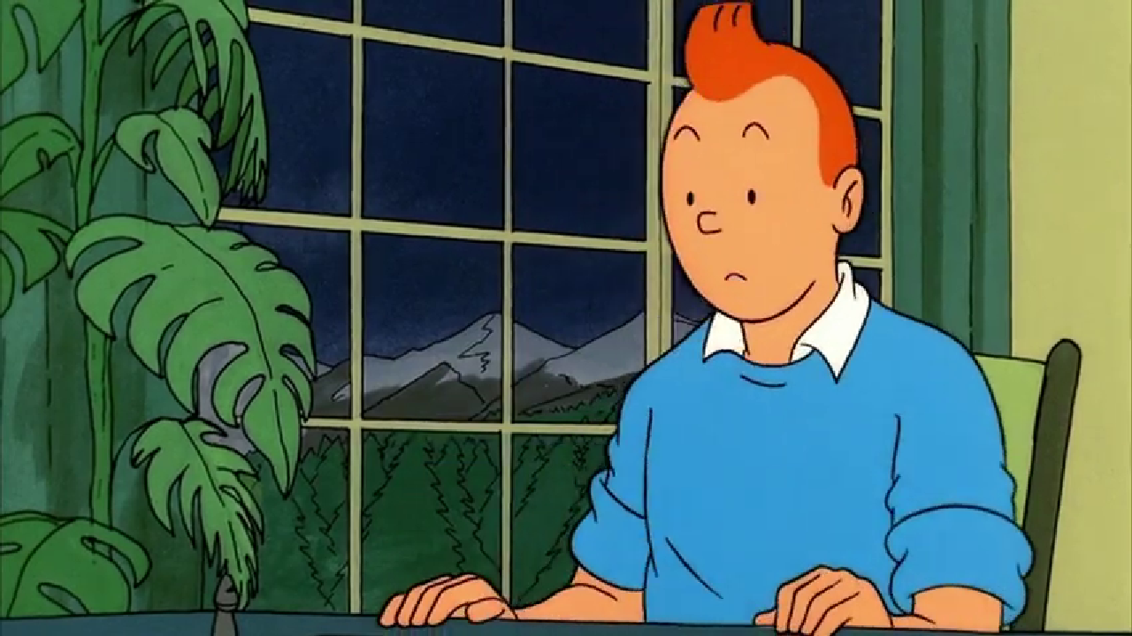

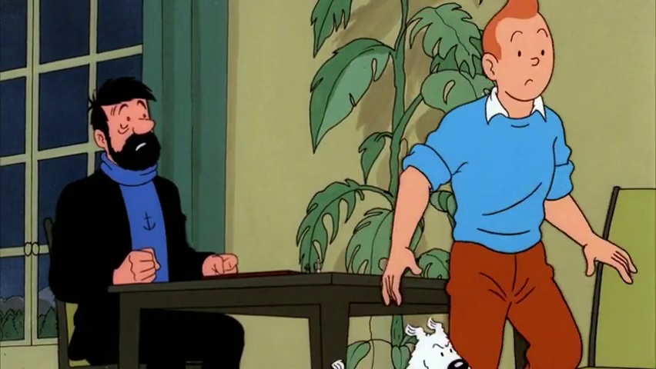
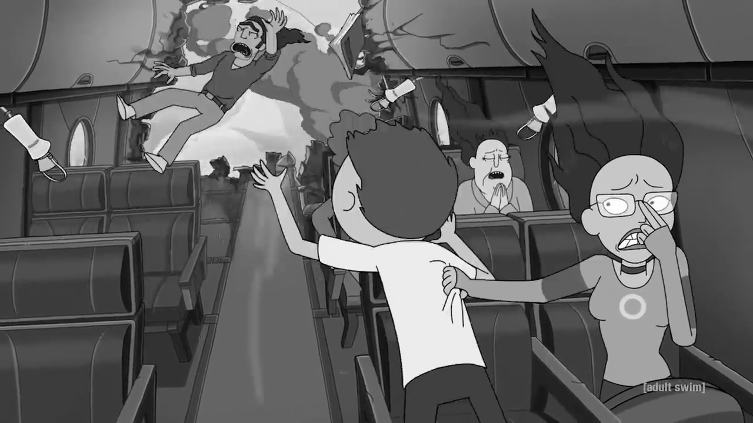

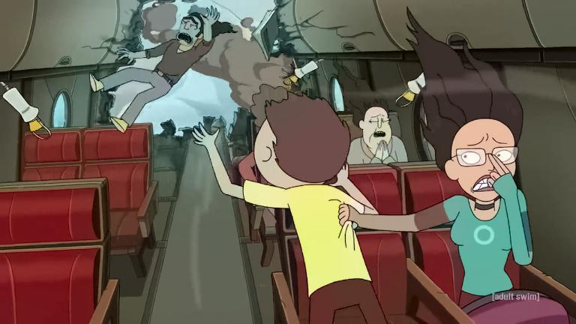




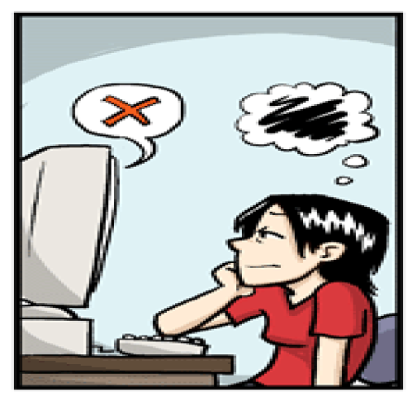
Method – Deep Exemplar-based Video Colorization
Input reference output ground truth

Slide 18
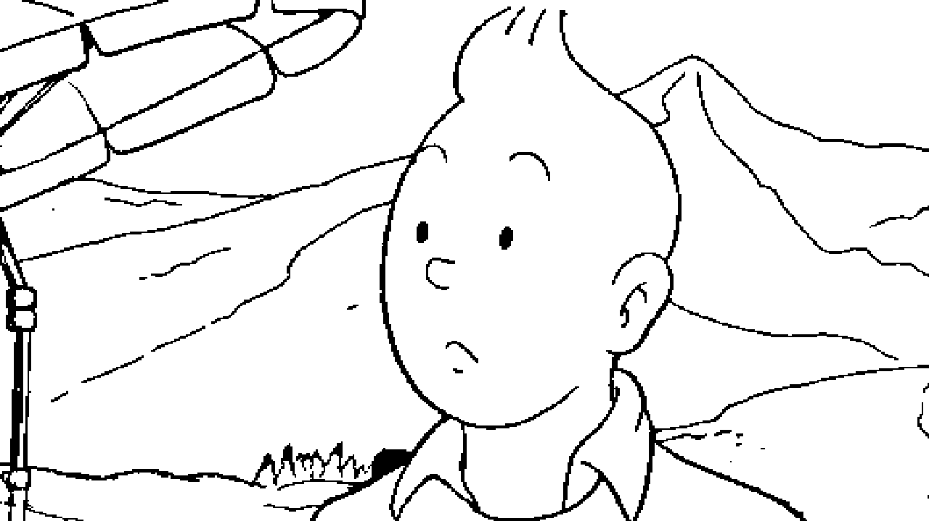
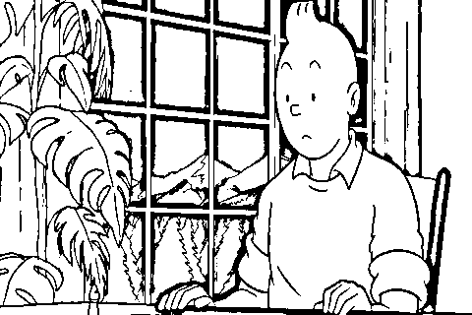

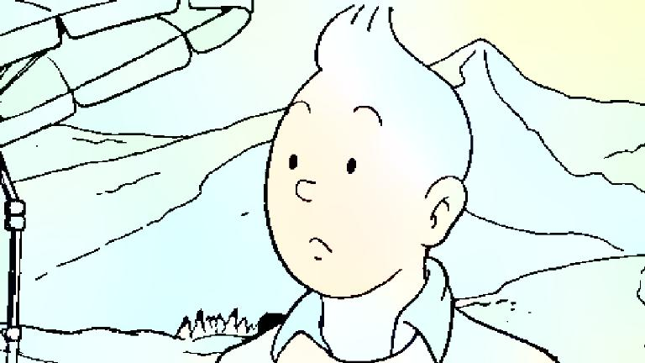
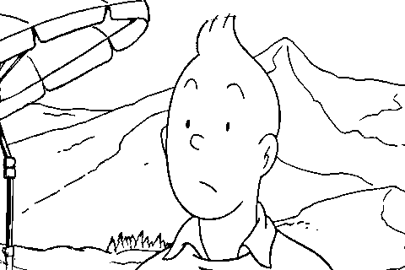
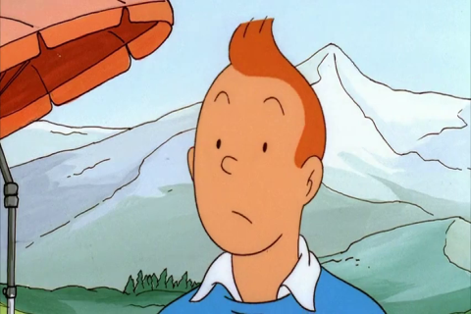
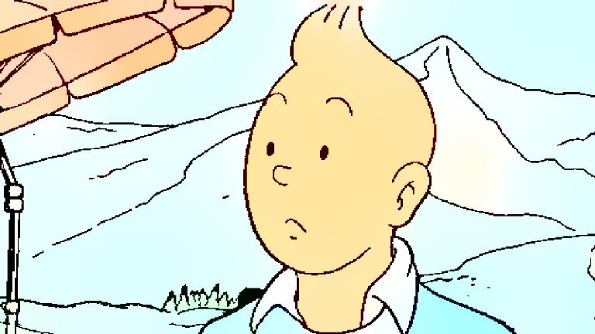

Slide 19








Training – Dataset
Comic
Video with comic style

Slide 20
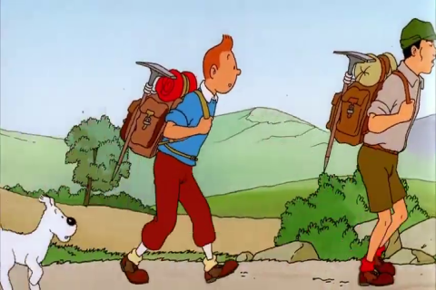
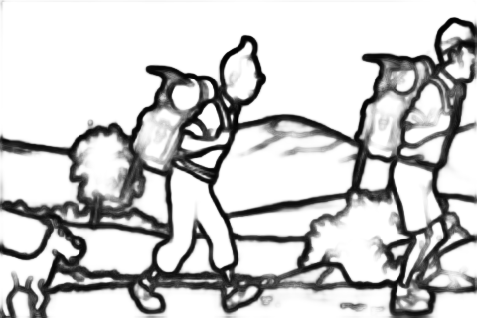

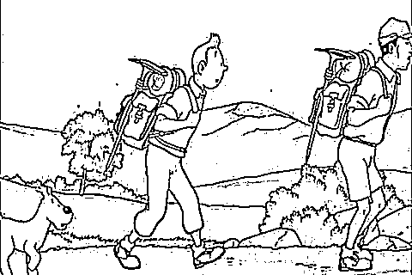

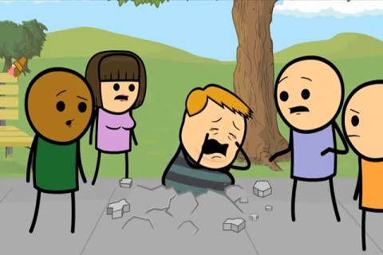
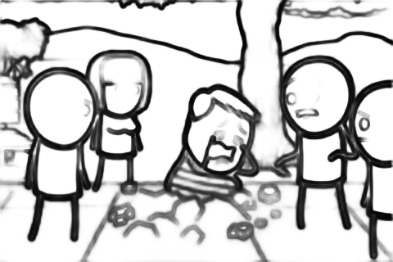
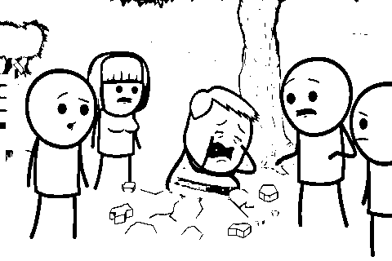
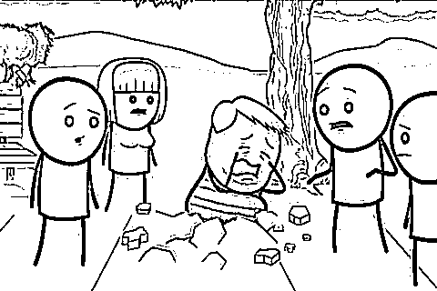
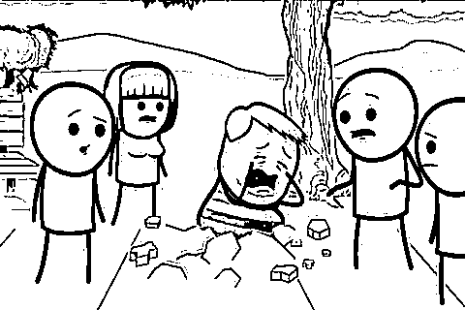
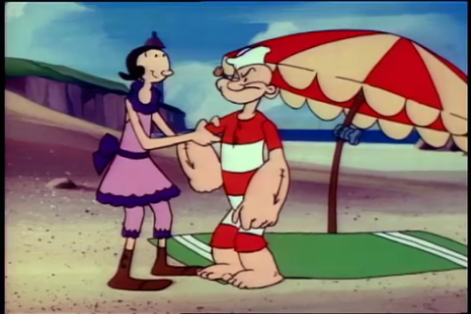
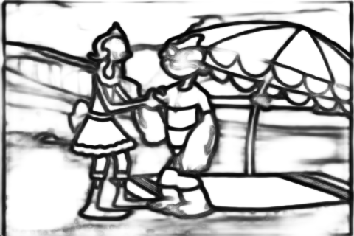
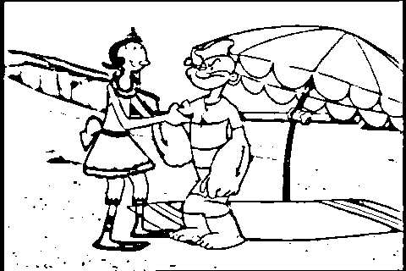
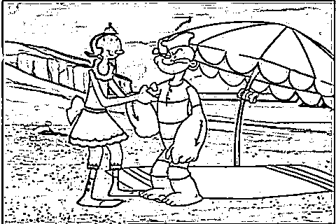
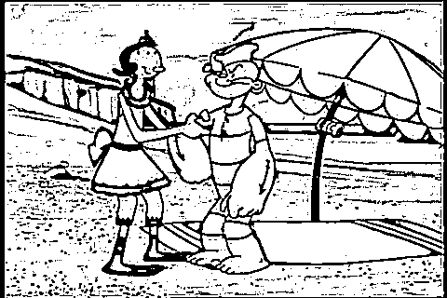
Training – Dataset
HED
Local threshold
Laplacian
Combined

Slide 21
Training – Network
Retrained the network: predict lab instead of only ab

Slide 22
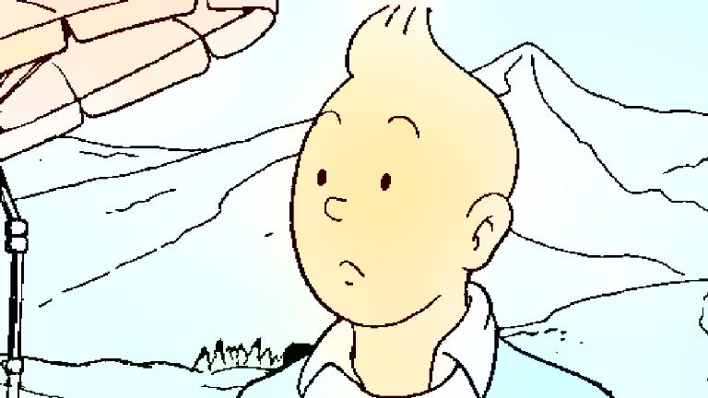
Training – Current result
After retraining

Slide 23
Training – Network
Retrained the network: predict lab instead of only ab
Will retrain a VGG for lineart

Slide 24

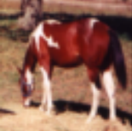
Other Method – Conditional Generative Flows (C-Glow)
Distribution B
Distribution B
Transformation Function
Condition C
Transformation Function
Condition C
Distribution A
Gaussian Distribution A

Slide 25


Other Method – Conditional Generative Flows (C-Glow)
Distribution B
Distribution B
Transformation Function
Condition C
Transformation Function
Invertible
Condition C
Distribution A
Gaussian Distribution A
B $=f\left(A\right)$
A $=f^{−1}\left(B\right)$

Slide 26



Other Method – Conditional Generative Flows (C-Glow)
Distribution B’
Distribution B
Transformation Function
Transformation Function
Condition C
Gaussian Distribution A’
Gaussian Distribution A

Slide 27
Other Method – Conditional Generative Flows (C-Glow)
Distribution B’
Distribution B
Transformation Function
Transformation Function
Condition C
Gaussian Distribution A’
≈
Gaussian Distribution A

Slide 28
Other Method – Conditional Generative Flows (C-Glow)
Lineart
Colorized image
Transformation Function
Transformation Function
Reference
Gaussian Distribution A
Gaussian Distribution A

Slide 29
Next step
Retrain a feature extractor for Deep Exemplar-based Video Colorization
Try C-Glow structure
Change the model into multi-reference

